Slide 1
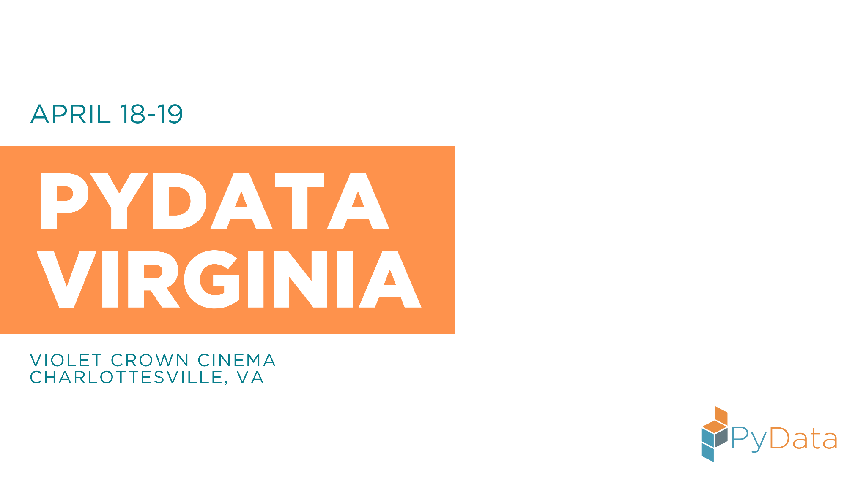
Build Your Data Science AI Agent
Chuxin Liu, Astha Puri, Niharika Krishnan, Michelle Rojas

Slide 2


Chuxin Liu
PhD in Economics,
Senior Associate @JPMorgan,
Community lead at AICamp & WiDS,
Love for running & cycling! 🏃‍♀️🚴

Slide 3


Astha Puri
Senior Data Scientist @CVS Health Founding Vice President - W2D2 Fostered 20+ cats and kittens

Slide 4


Niharika Krishnan
Machine Learning Engineer - Quant Finance & AI PyLadies & WiDS NYC Organizer Board game geek & adventure lover!
All thoughts, views and code in this talk & tutorial are my own and do not represent my employer

Slide 5

Michelle Rojas
Backend Engineer for 10+ years
Rust NYC Organizer and WiDS Loves volcanoes, dragons, OpenTelemetry (OTCA Certification Coming Soon…)

Slide 6
About this tutorial
You will have…
An overview of AI agents and its use cases
Hands-on workshop in building AI agent for data science
Understanding of its deployment, evaluation and challenges
Let’s dive in!
Notes:
chuxin

Slide 7
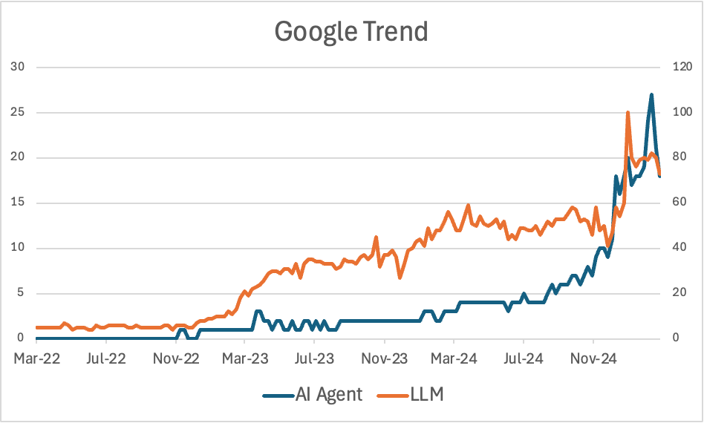
From LLM to Agents
Notes:
chuxin

Slide 8
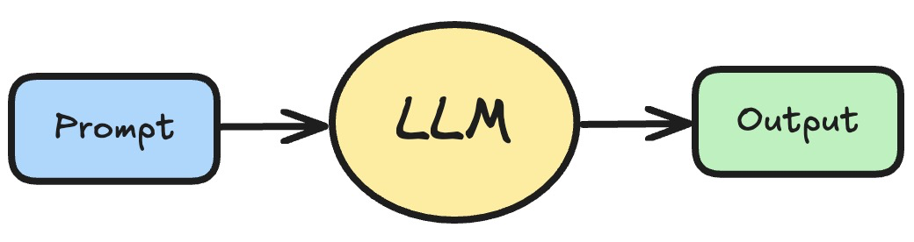

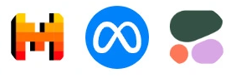
From LLM to Agents
Three years ago, we started from …
Notes:
chuxin

Slide 9
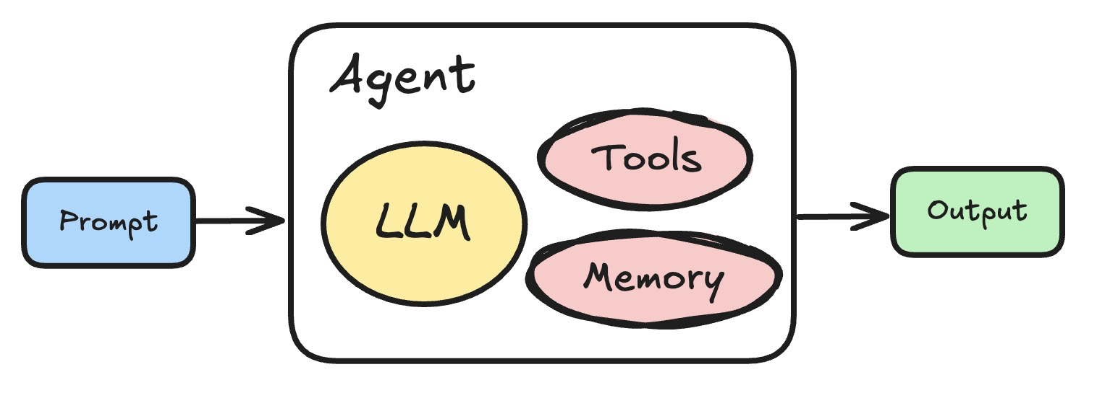
… to Agents!
✅ Orchestration
✅ Memory - short term and long term
✅ Tools - APIs, Functions, Databases, etc.
Notes:
chuxin

Slide 10
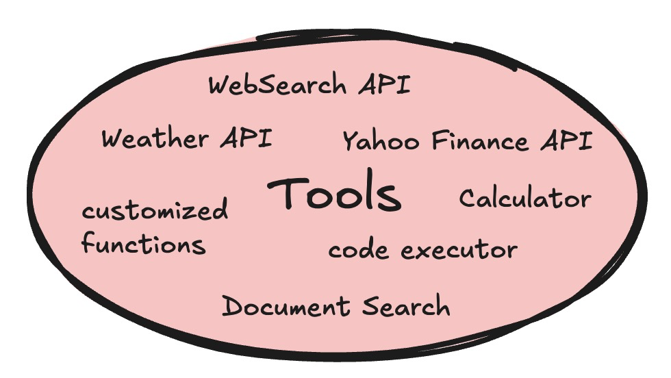
Agents use Tools - We make LLM “do” things for us
RAG (Retrieval augmented generation)
Notes:
chuxin

Slide 11
Examples of AI agents
Customer service
Marketing research
Financial research and analysis
Social media campaigns
Agentic coding tools
…
Notes:
chuxin

Slide 12
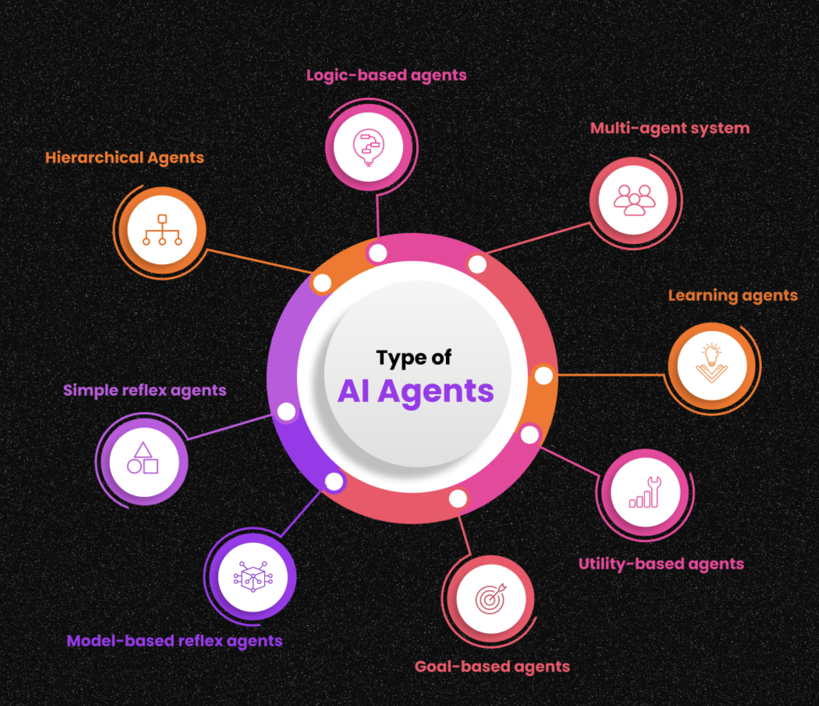
How to get started?
Simple Reflex Agent:
Rule based, no memory
Set temp to 100
Model based reflex:
Current perception & memory
Robot vacuum cleaner
Goal based agents
Search & planning
Robot delivering packages
Utility based
Multiple options, end-use-case at core
Self driving cars
Learning agents:
Interacts with user, learns
Siri
Hierarchical/Supervisor
High level - couple of sub agents
Image Source: https://www.ampcome.com/post/ai-agents-definition-types-benefits-use-cases
Notes:
Niharika

Slide 13
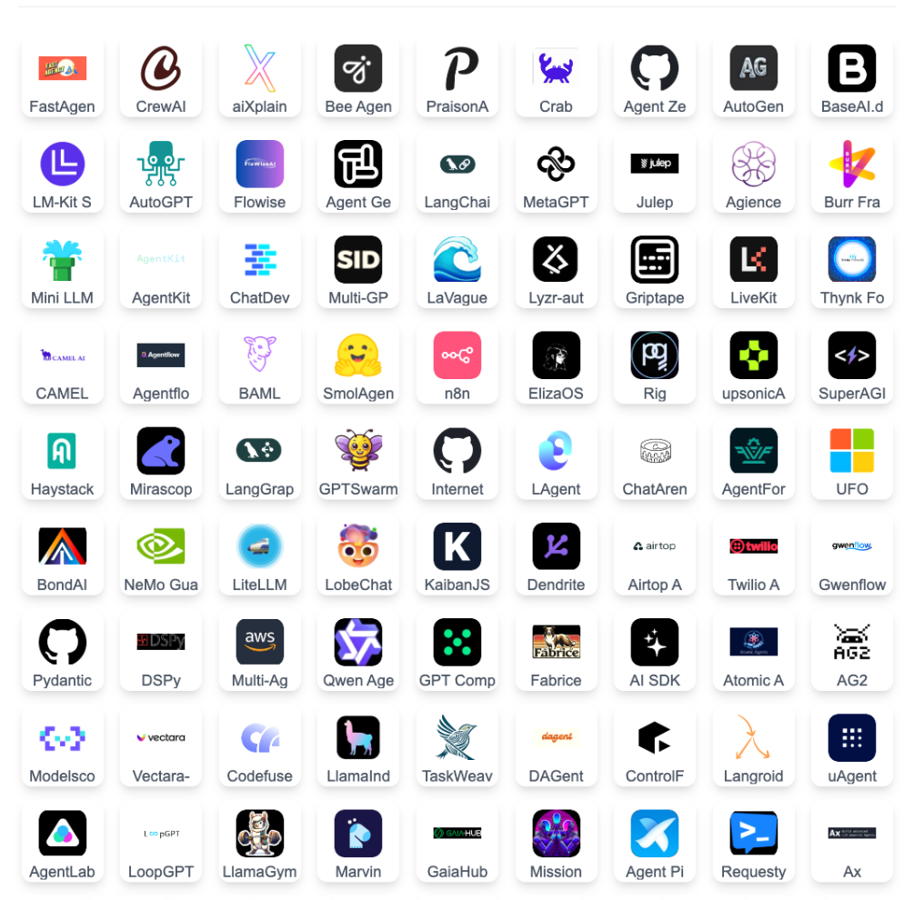

Agent Frameworks
That’s too much!
Notes:
Niharika

Slide 14
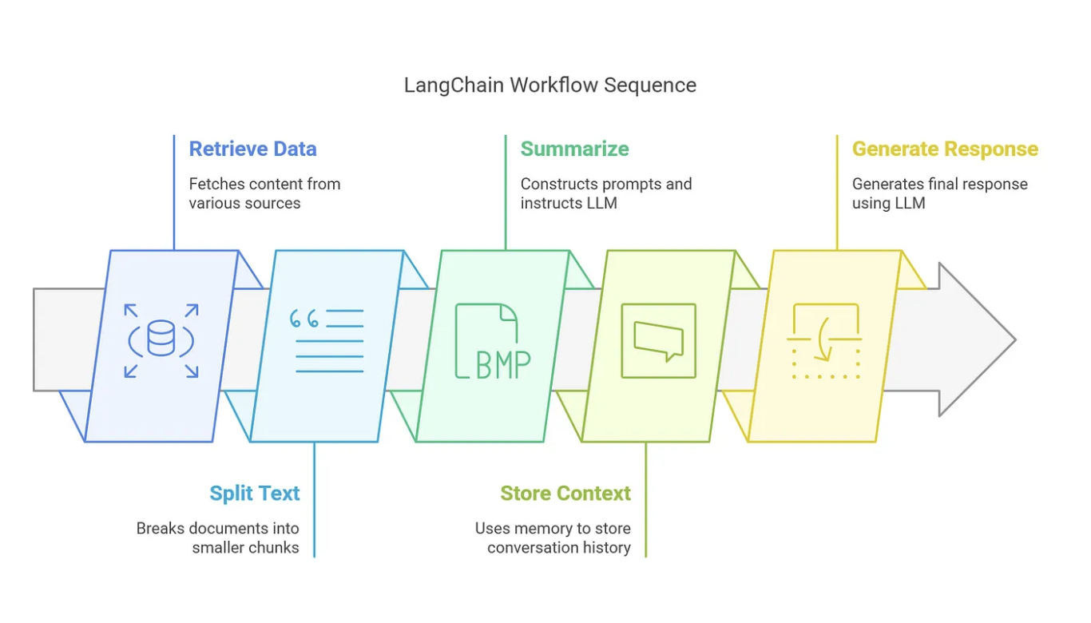
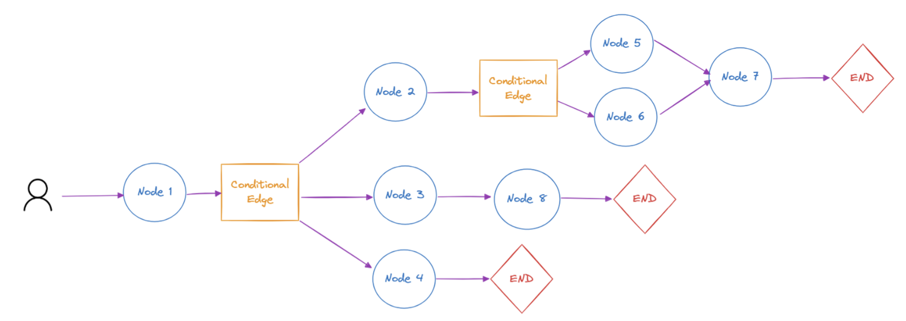
LangChain & LangGraph
LangChain
Chaining LLM Operations
High-level framework
Sequence of functions — structured as a chain
Each step depends on the output of the previous one
Modularity: Mix and match LLMs
LangGraph
Built on top of LangChain
Stateful, Non-linear workflows
Directed Graphs
Multi-step or multi-agent workflows with feedback loops.
Handle conditional logic, stateful interactions
ReAct (Reasoning and Action): Instruct agents to "think" and plan after each action
THINK. ACT. OBSERVE
Image source: https://medium.com/@tahirbalarabe2/%EF%B8%8Flangchain-vs-langgraph-a-comparative-analysis-ce7749a80d9c
https://www.ionio.ai/blog/a-comprehensive-guide-about-langgraph-code-included
Notes:
Niharika

Slide 15
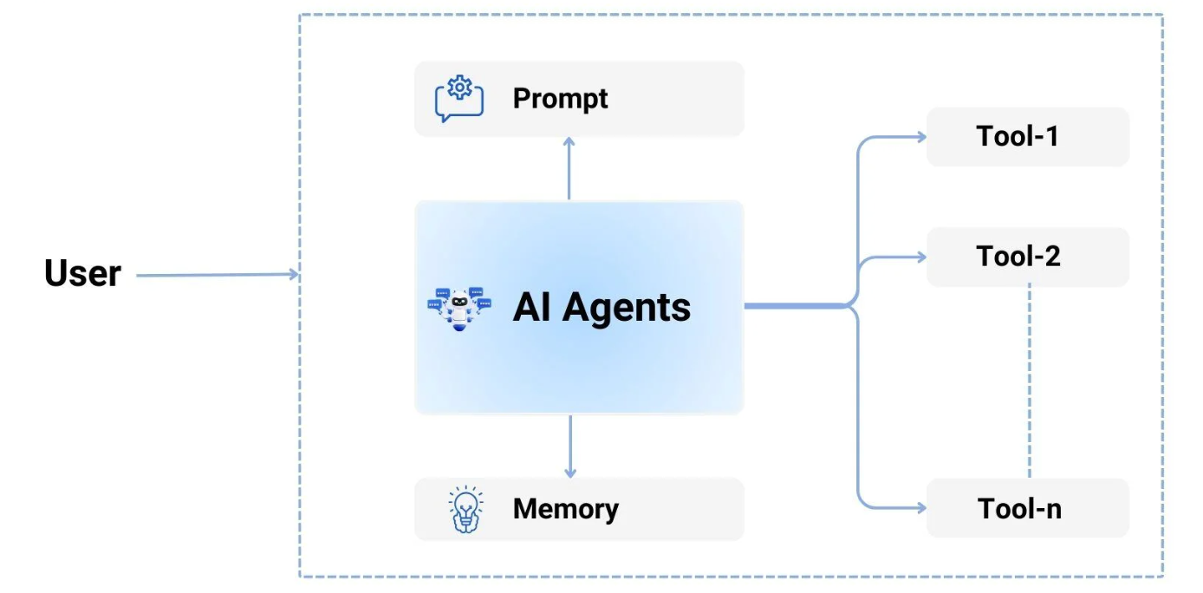
Single vs Multi-Agent
Control flow of applications
Problems:
Too many tools
Complex context
Multiple specialization

Slide 16
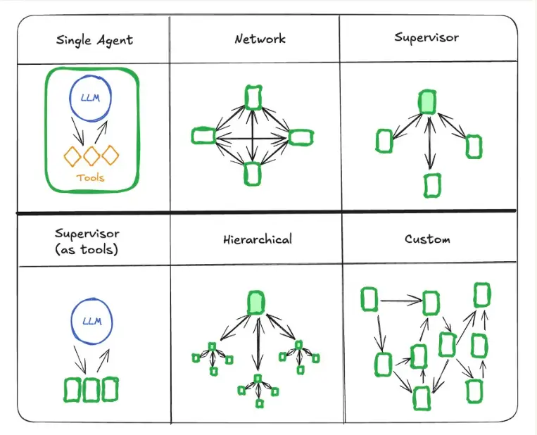
Types of Multi-Agent
Multi agent:
Prompt + LLM → React agent
Agent = graph node
Decision to finish or route
Pass state vs tool call arguments
Notes:
Astha

Slide 17
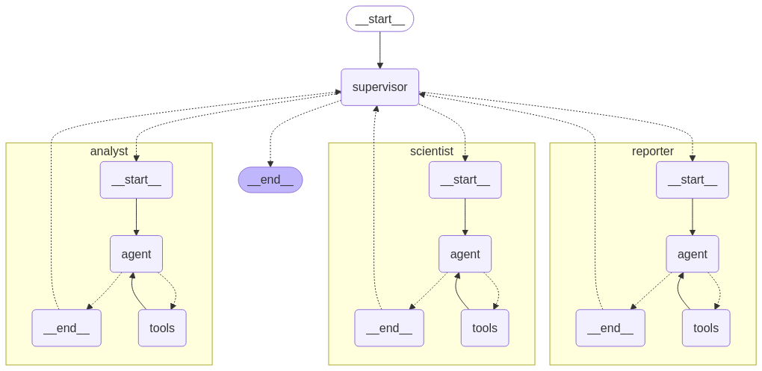
Multi-Agent system for data science
Notes:
Astha

Slide 18


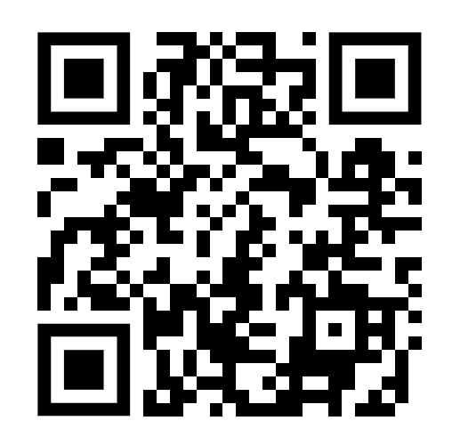
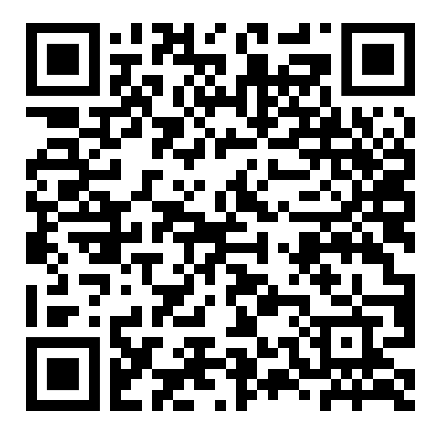
Tutorial
To create an OpenAI API Key： https://tinyurl.com/5n6mk2p2
To get data and notebook: https://tinyurl.com/3v7t26k7

Slide 19


Slide 20
Langsmith - a platform for evaluation
Created by LangChain to help debug, test, evaluate, and monitor LLM applications
Provides tracing capabilities to visualize the execution of chains and agents
Offers dataset creation and management for systematic testing
Includes evaluation tools to measure performance against metrics like accuracy
Enables monitoring of production deployments to track performance over time
Integrates with popular LLM frameworks beyond just LangChain
Notes:
Michelle

Slide 21
Evaluation
Metrics
Task completion rate
Recall/precision/accuracy/F1
Latency
Resources Usage
User Satisfaction
Bias and fairness
Layers of an agentic system
Entire multi-agent system
Each single agent
Hand-offs between agents
Tool calls by agent
LLM

Slide 22
Deployment
Streamlit Demo
Notes:
Michelle

Slide 23

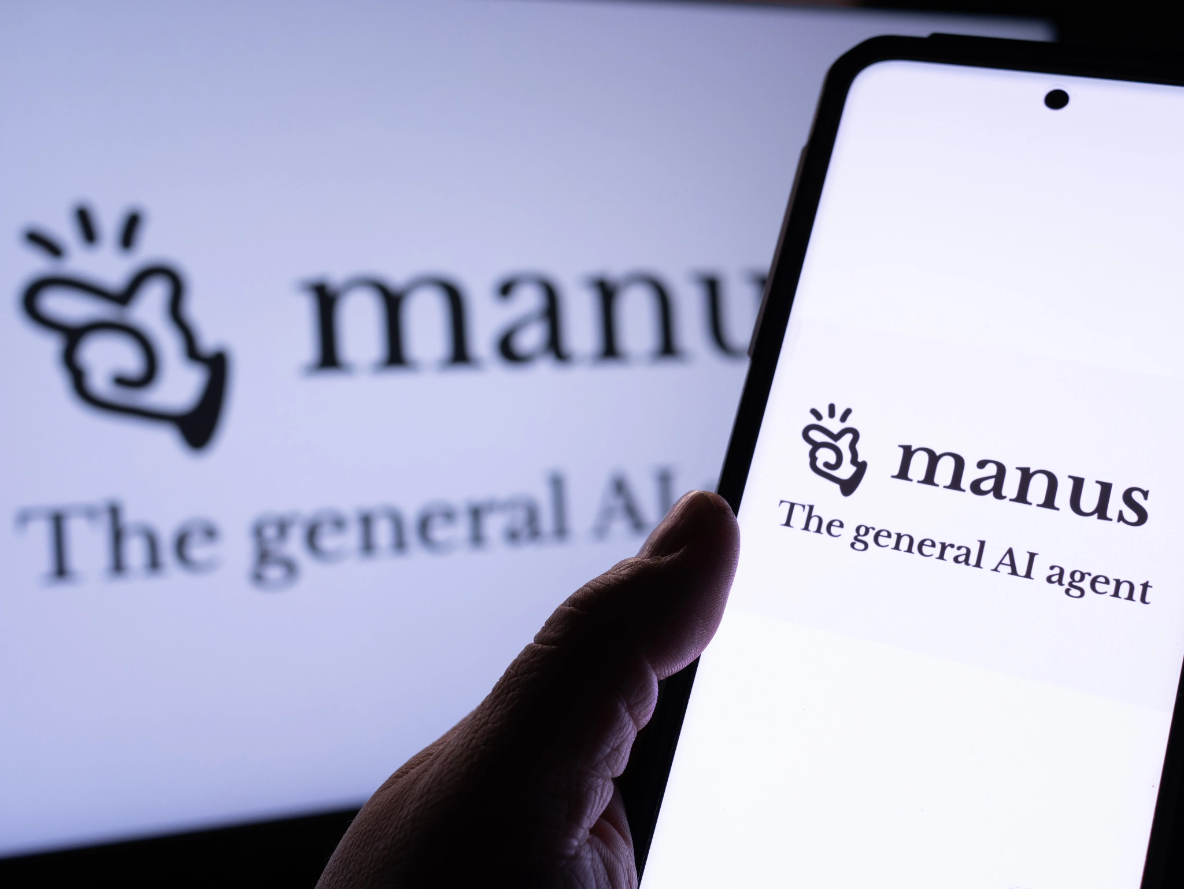





What’s Coming?
AI agents landscape is fastly evolving in the speed of every day!

Slide 24
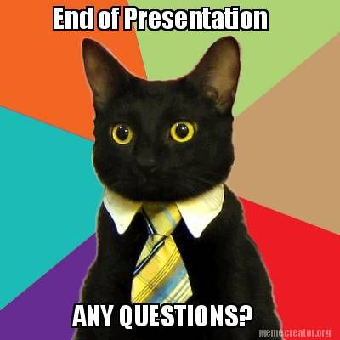

Slide 25
We are here!

Slide 26
Let’s wrap them up!

Slide 27
We are here!

Slide 28
We are here!

Slide 29
We are here!

Slide 30
We are here!

Slide 31
We are here!

Slide 32
We are here!

Slide 33
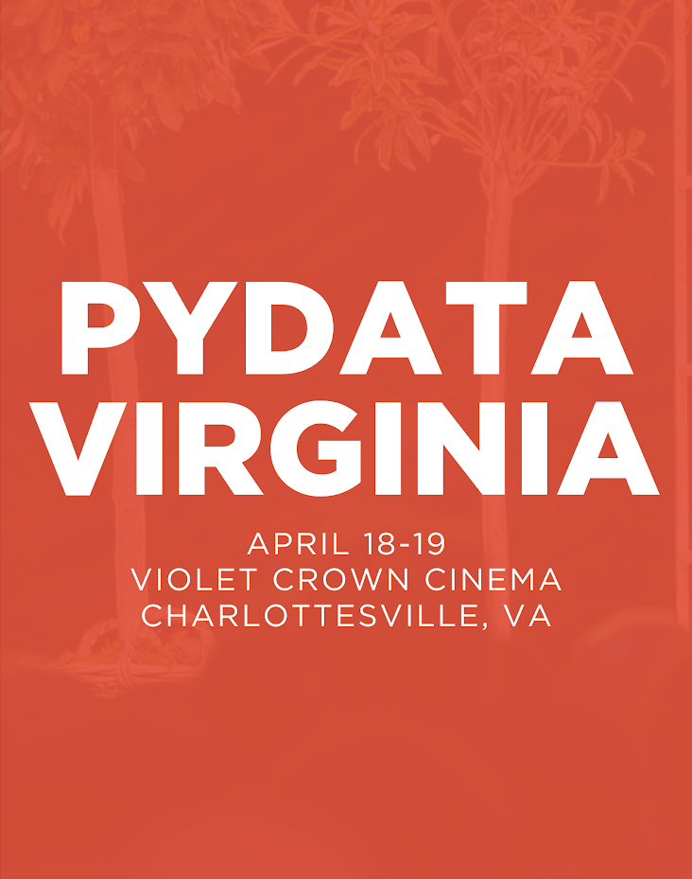

Slide 34
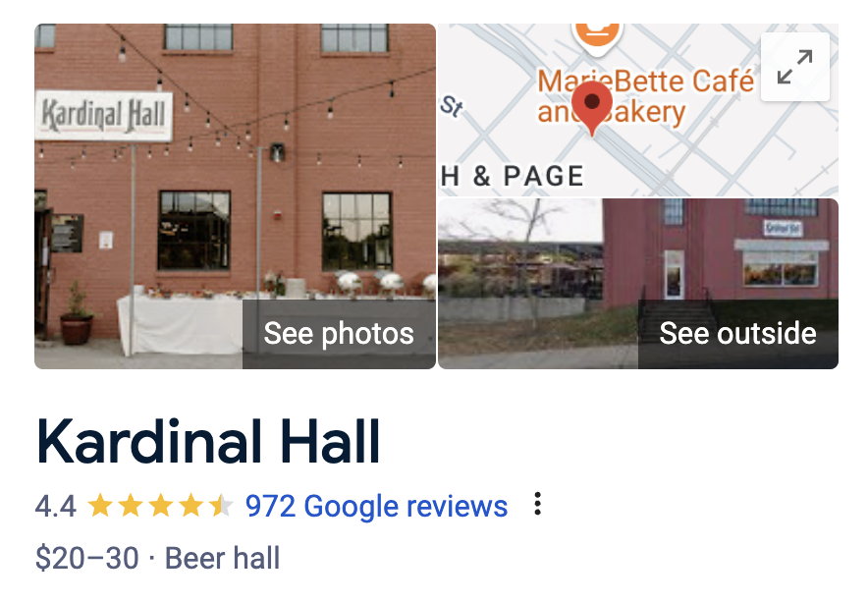
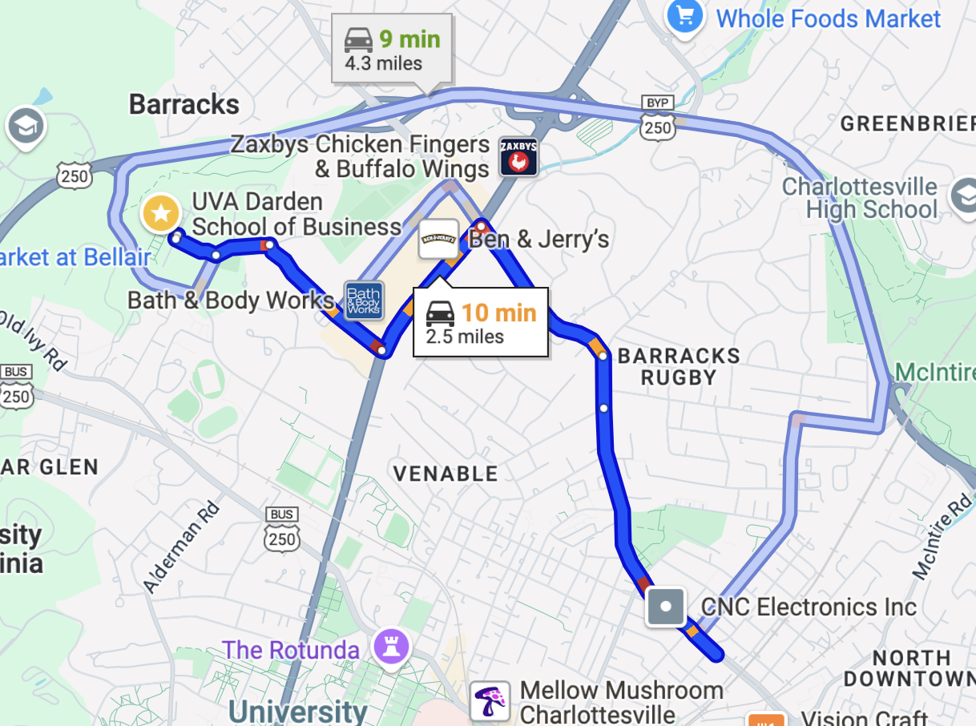
Happy Hour at Kardinal Hall, 5:30pm

